Slide 1
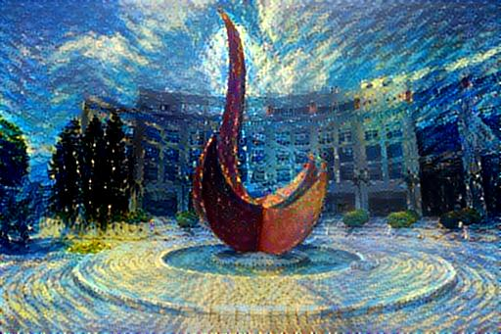
An Introduction to Reinforcement Learning
Yuan YAO
HKUST

Slide 2
Supervised Learning
Data: (x, y) x is input, y is output/response (label)
Goal: Learn a function to map x -> y
Examples:
Classification,
regression,
object detection,
semantic segmentation,
image captioning, etc.
Cat

Slide 3
Unsupervised Learning
Data: x Just input data, no output labels!
Goal: Learn some underlying hidden structure of the data
Examples:
Clustering,
dimensionality reduction (manifold learning),
feature learning,
density estimation,
Generating samples, etc.

Slide 4
Today: Reinforcement Learning
Problems involving an agent
interacting with an environment,
which provides numeric reward signals
Goal:
Learn how to take actions in order to maximize reward in dynamic scenarios

Slide 5
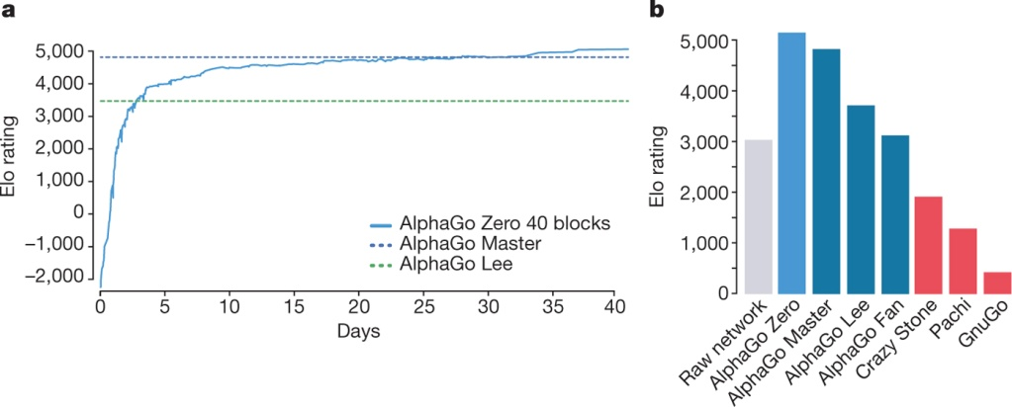
Playing games against human champions
AlphaGo “LEE” 2016
Deep Blue in 1997
AlphaGo ”ZERO” D Silver et al. Nature 550, 354–359 (2017) doi:10.1038/nature24270

Slide 6
Outline
What is Reinforcement Learning?
Markov Decision Processes
Bellman Equation as Linear Programming
Q-Learning
Policy Gradients
An Example of Auction Sell via Discrete Q-Learning by Prof. Michael Kearns

Slide 12
Car-Pole Control Problem

Slide 14
Mathematical Formulation of Reinforcement Learning
Markov property: Current state completely characterizes the state of the world

Slide 15
At time step t=0, environment samples initial state s0 ~ p(s0)
Then, for t=0 until done:
Agent selects action at
Environment samples reward rt ~ R( . | st, at)
Environment samples next state st+1 ~ P( . | st; at)
Agent receives reward rt and next state st+1
A policy 𝜋 is a function from S to A that specifies what action to take in each state
Objective: find policy that maximizes the cumulated discounted reward

Slide 20
Bellman Equation of Optimal Value
Remarks
• In the continuous-time analog of MDP, i.e., stochastic optimal control, the Bellman equation is the HJB
• Exact solution methods: value iteration, policy iteration, variational analysis
• What makes things hard:
Curse of dimensionality + Modeling Uncertainty

Slide 21
Bellman Equation as LP (Farias and Van Roy, 2003)

Slide 22
Duality between Value Function and Policy

Slide 23
Online Value-Policy Iteration (Mengdi Wang 2017, arXiv:1704.01869)

Slide 24
Near Optimal Primal-Dual Algorithms
Mengdi Wang, Primal-Dual π Learning, arXiv:1710.0610

Slide 25
Q-Learning

Slide 34
Training the Q-network: Experience Replay
Learning from batches of consecutive samples is problematic:
Samples are correlated => inefficient learning
Current Q-network parameters determines next training samples (e.g. if maximizing action is to move left, training samples will be dominated by samples from left-hand size) => can lead to bad feedback loops
Address these problems using experience replay
Continually update a replay memory table of transitions (s_{t}, a_{t}, r_{t}, s_{t+1}) as game (experience) episodes are played
Train Q-network on random minibatches of transitions from the replay memory, instead of consecutive samples
Each transition can also contribute to multiple weight updates => greater data efficiency

Slide 36
Example
https://www.youtube.com/watch?v=V1eYniJ0Rnk

Slide 37
Policy Gradients
What is a problem with Q-learning? The Q-function can be very complicated!
Example: a robot grasping an object has a very high-dimensional state => hard to learn exact value of every (state, action) pair
But the policy can be much simpler: just close your hand Can we learn a policy directly, e.g. finding the best policy from a collection of policies?

Slide 51
Pytorch Implementation
https://github.com/kevinzakka/recurrent-visual-attention
A Pytorch implementation for the paper, Recurrent Models of Visual Attention by Volodymyr Mnih, Nicolas Heess, Alex Graves and Koray Kavukcuoglu, NIPS 2014.

Slide 53
Summary
Policy gradients: very general but suffer from high variance so requires a lot of samples. Challenge: sample-efficiency
Q-learning: does not always work but when it works, usually more sample-efficient. Challenge: exploration
Guarantees:
Policy Gradients: Converges to a local minima, often good enough!
Q-learning: Zero guarantees since you are approximating Bellman equation with a complicated function approximator

Slide 54
A Brief Field Guide to Wall Street
“Buy Side”: Attempt to outperform market via proprietary research
Includes hedge funds, mutual funds, statistical arbitrage, HFT, prop trading groups
May or may not be quantitative and automated
Have investors but not clients
Take and hold positions → risk
Generation of “alpha” still more art than science
“Sell Side”: Provide brokerage and execution services
Includes bank and independent brokerages, exchanges
Almost entirely quantitative and automated
Clients are the buy side
Do not hold risk; paid via fees/commissions/etc.
In reality, alpha and execution are blurred
Especially at shorter holding periods (e.g. HFT)

Slide 55
Optimized Execution, Market Microstructure and Reinforcement Learning
[Y. Nevmyvaka. Y. Feng, MK; ICML 2006]
[MK, Y. Nevmyvaka; In “High Frequency Trading”, O’Hara et al. eds, Risk Books 2013]
Michael Kearns, University of Pennsylvania, ICML 2014, Beijing

Slide 56
A Canonical Trading Problem
Goal (buy side to sell side): Sell V shares in T time steps; maximize revenue
Benchmarks:
Volume Weighted Average Price (VWAP)
Time Weighted Average Price (TWAP)
Implementation Shortfall (midpoint of bid-ask spread at beginning)
Natural to view as a problem of state-based control (RL)
State variables: inventory and time remaining (discretized)
Features capturing market activity?

Slide 57
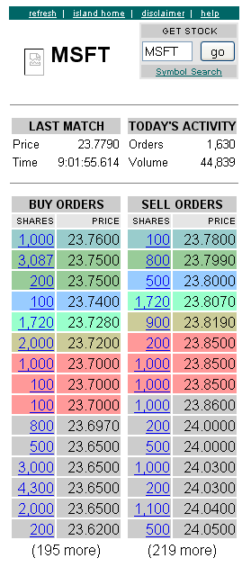
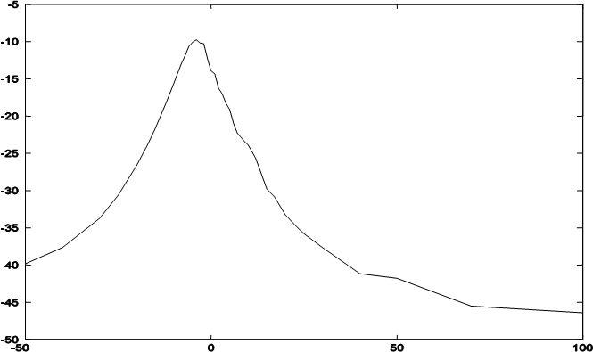
Market Microstructure
Continuous double auction with limit orders
Volatile and dynamic; sub-millisecond time scale
Cancellations, revisions, partial executions
How do individual orders (micro) influence aggregate market behavior (macro)?
Tradeoff between immediacy and price
Seen in “submit and leave” strategies:
initial midpoint
Implementation Shortfall vs. Limit Price
deep in book
market order

Slide 58
Policies Learned: Time and Volume Remaining
Experimental framework
Full historical order book reconstruction and simulation
Learn optimal policy on 1 year training; test on following 6 months
Pitfalls: directional drift, “counterfactual” market impact
Overall shape is consistent and sensible
Become more aggressive (spread crossing) as time runs out or inventory is too large
Learning optimizes this qualitative schedule

Slide 59
Additional Improvement From Order Book Features
Bid Volume | -0.06% | Ask Volume | -0.28%
Bid-Ask Volume Misbalance | 0.13% | Bid-Ask Spread | 7.97%
Price Level | 0.26% | Immediate Market Order Cost | 4.26%
Signed Transaction Volume | 2.81% | Price Volatility | -0.55%
Spread Volatility | 1.89% | Signed Incoming Volume | 0.59%
Spread + Immediate Cost | 8.69% | Spread+ImmCost+Signed Vol | 12.85%

Slide 60
A Challenge for Option A Projects:
https://github.com/Ceruleanacg/Personae/blob/master/README.md
This is a good start for the application of reinforcement learning in trading.
Can you reproduce the results there?

Slide 61
Thank you!

